Slide 1
Measuring Effort for a Project
1

Slide 2
Measuring Effort for a Project
2
Measuring the effort for a project is a specialized activity.
It enables you to derive cost estimates that are critical for project management. An incorrect measurement of effort at the beginning of project can result in inaccurate project plans and frequent slippages.
It can also lead to inaccurate cost estimates, which can cause steep cost deviations between estimated and actual cost values.

Slide 3
Measuring Effort for a Project
There are many techniques that you can use to accurately estimate effort, such as:
a) Source lines of Code (SLOC)
b) Function Point (FP)
c) Constructive Cost Model (COCOMO)

Slide 4
Lines of Code (LOC)
Size Estimation
Lines of Code (LOC)
Fig. 2: Function for sorting an array
1. | int. sort (int x[ ], int n)
2. | {
3. | int i, j, save, im1;
4. | /*This function sorts array x in ascending order */
5. | If (n<2) return 1;
6. | for (i=2; i<=n; i++)
7. | {
8. | im1=i-1;
9. | for (j=1; j<=im; j++)
10. | if (x[i] < x[j])
11. | {
12. | Save = x[i];
13. | x[i] = x[j];
14. | x[j] = save;
15. | }
16. | }
17. | return 0;
18. | }
If LOC is simply a count of the number of lines then figure shown below contains 18 LOC .
When comments and blank lines are ignored, the program in figure 2 shown below contains 17 LOC.
5

Slide 5
Lines of Code (LOC)
“A line of code is any line of program text that is not a comment or blank line, regardless of the number of statements or fragments of statements on the line. This specifically includes all lines containing program header, declaration, and executable and non-executable statements”.
This is the predominant definition for lines of code used by researchers. By this definition, figure shown above has 17 LOC.

Slide 6
Disadvantages
The SLOC technique is language-dependent. The effort required to calculate source lines of code may not be the same for all languages.
For example, to conceive and write 8 lines of code that accomplish a task in the assembly language may require 15 minutes. However, you may need only five minutes to complete the same lines of code if it is written in Visual Basic.

Slide 7
Functional Point Analysis
1
0
The principle of function point analysis (FPA) is that a system is decomposed into functional units.
Inputs
Outputs
Enquiries
:
:
:
information entering the system
information leaving the system
requests for instant access to information
information held within
the system
information held by other system that is used by the system being analyzed.
Internal logical files
External interface
files
:
:

Slide 8
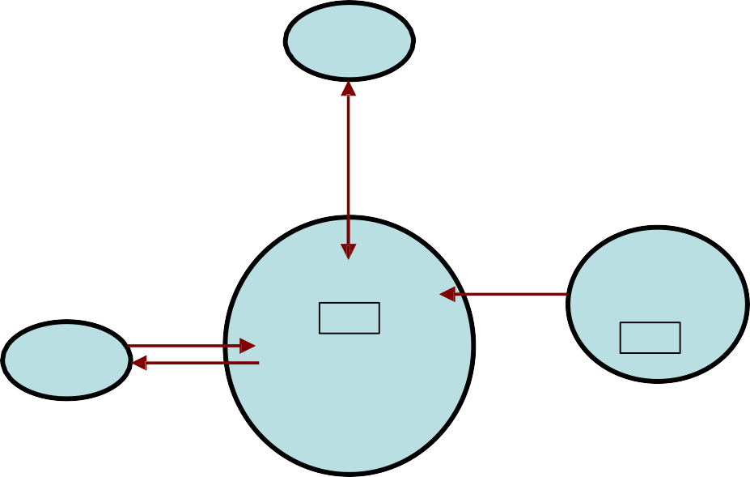
Functional Point Analysis
1
1
The FPA functional units are shown in figure given below:
User
Inquiries
Other
applications
EIF
Inputs
ILF
User
Outputs
ILF: Internal logical files
EIF: External interfaces
System
Fig. 3: FPAs functional units System

Slide 9
Functional Point Analysis
1
4
Special features
Function point approach is independent of the language, tools, or methodologies used for implementation; i.e. they do not take into consideration programming languages, data base management systems, processing hardware or any other data base technology.
Function points can be estimated from requirement specification or design specification, thus making it possible to estimate development efforts in early phases of development.

Slide 10
Functional Point Analysis
1
5
Function points are directly linked to the statement of requirements; any change of requirements can easily be followed by a re-estimate.
Function points are based on the system user’s external view of the system, non-technical users of the software system have a better understanding of what function points are measuring.

Slide 11
Functional Point Analysis
Counting function points
Functional Units | Weighting factors
 | Low | Average | High
External Inputs (EI) | 3 | 4 | 6
External Output (EO) | 4 | 5 | 7
External Inquiries (EQ) | 3 | 4 | 6
External logical files (ILF) | 7 | 10 | 15
External Interface files (EIF) | 5 | 7 | 10
Table 1 : Functional units with weighting factors

Slide 12
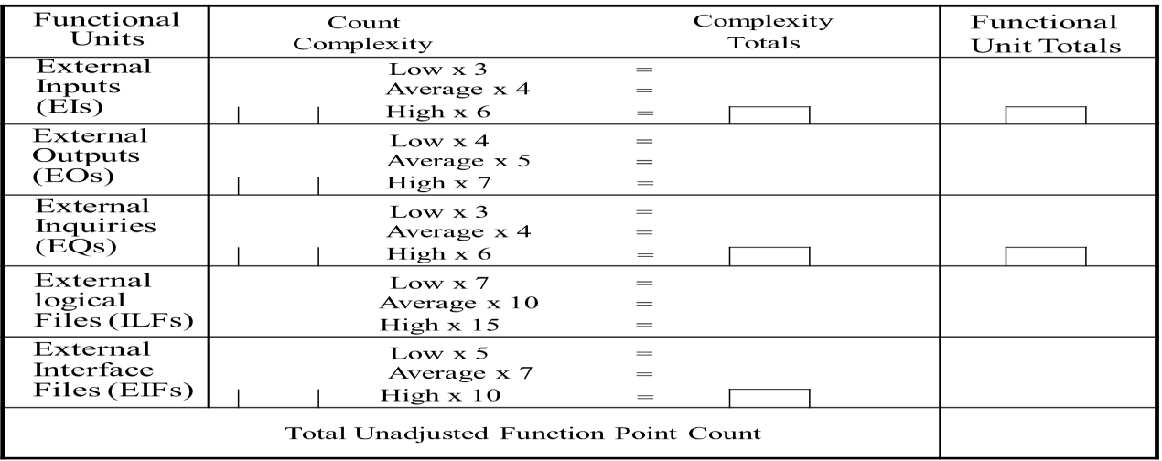
1
7

Slide 13
Functional Point Analysis
1
8
The weighting factors are identified
for all
functional units and multiplied with the functional units accordingly. The procedure for the calculation of Unadjusted Function Point (UFP) is given in table shown above.

Slide 14
Functional Point Analysis
1
9
The procedure for the calculation of UFP in mathematical form is given below:
5 3
UFP = ∑∑Z_{ij} w_{ij}
i=1 J =1
Where i indicate the row and j indicates the column of Table 1
W_{ij} : It is the entry of the i^{th} row and j^{th} column of the table 1
Zij : It is the count of the number of functional units of Type i that have been classified as having the complexity corresponding to column j.

Slide 15
Functional Point Analysis
2
0
Organizations that use function point methods develop a criterion for determining whether a particular entry is Low, Average or High. Nonetheless, the determination of complexity is somewhat subjective.
FP = UFP * CAF
Where CAF is complexity adjustment factor and is equal to [0.65 +
0.01 x ΣF_{i}]. The F_{i} (i=1 to 14) are the degree of influence and are
based on responses to questions noted in table 3.

Slide 16
2
1
Table 3 : Computing function points.
Rate each factor on a scale of 0 to 5.
0 1 2 3
4
5
No Influence
Average
Essential
Incidental Moderate Significant
Number of factors considered ( F_{i} )
Does the system require reliable backup and recovery ?
Is data communication required ?
Are there distributed processing functions ?
Is performance critical ?
Will the system run in an existing heavily utilized operational environment ?
Does the system require on line data entry ?
Does the on line data entry require the input transaction to be built over multiple screens or operations ?
Are the master files updated on line ?
Is the inputs, outputs, files, or inquiries complex ?
Is the internal processing complex ?
Is the code designed to be reusable ?
Are conversion and installation included in the design ?
Is the system designed for multiple installations in different organizations ?
Is the application designed to facilitate change and ease of use by the user ?

Slide 17
Functional Point Analysis
2
2
Functions points may compute the following important metrics:
Productivity
Quality Cost
Documentation
=
=
FP / persons-months Defects / FP
Rupees / FP
Pages of documentation per
=
=
FP
These metrics are controversial and are not universally acceptable.
There are standards issued by the International Functions Point User Group (IFPUG, covering the Albrecht method) and the United Kingdom Function Point User Group (UFPGU, covering the MK11 method). An ISO standard for function point method is also being developed.

Slide 18
Functional Point Analysis
2
3
Example: 4.1
Consider a project with the following functional units:
Number of user inputs Number of user outputs Number of user enquiries Number of user files
Number of external interfaces
= 50
= 40
= 35
= 06
= 04
Assume all complexity adjustment factors and weighting factors are
average. Compute the function points for the project.

Slide 19
Functional Point Analysis
We know
5 3
UFP = ∑∑Z_{ij} w_{ij}
i=1 J =1
UFP = 50 x 4 + 40 x 5 + 35 x 4 + 6 x 10 + 4 x 7
= 200 + 200 + 140 + 60 + 28 = 628
CAF = (0.65 + 0.01 ΣF_{i})
= (0.65 + 0.01 (42)) = 0.65 + 0.42 = 1.07
FP = UFP x CAF
= 628 x 1.07 = 672

Slide 20
Functional Point Analysis
2
5
Example:4.2
An application has the following:
10 low external inputs, 12 high external outputs, 20 low internal logical files, 15 high external interface files, 12
average external
inquiries, and a value of complexity
adjustment factor of 1.10.
What are the unadjusted and adjusted function point counts ?

Slide 21
Functional Point Analysis
2
6
Unadjusted function point counts may be calculated using
UFP = ∑∑Z_{ij} w_{ij}
i=1 J =1
= 10 x 3 + 12 x 7 + 20 x 7 + 15 x 10 + 12 x 4
= 30 + 84 +140 + 150 + 48
= 452
FP = UFP x CAF
= 452 x 1.10 = 497.2.

Slide 22
Functional Point Analysis
2
7
Example: 4.3
Consider a project with the following parameters.
External Inputs:
10 with low complexity (b)15 with average complexity
(c) 17 with high complexity
External Outputs:
6 with low complexity
(b)13 with high complexity
External Inquiries:
3 with low complexity
4 with average complexity
2 high complexity

Slide 23
Functional Point Analysis
2
8
Internal logical files:
(a) 2 with averagecomplexity (b)1 with high
complexity
External Interface files:
(a) 9 with low complexity
In addition to above, system requires
Significant data communication
Performance is very critical
Designed code may be moderately reusable
System is not designed for multiple installation in different organizations.
Other complexity adjustment factors are treated as average. Compute the function points for the project.

Slide 24
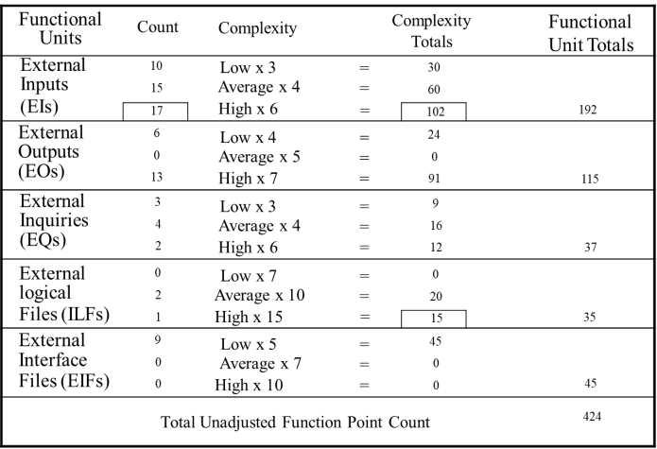

Slide 25
Functional Point Analysis
3
0
∑F_{i} = 3+4+3+5+3+3+3+3+3+3+2+3+0+3=41
i=1
14
CAF = (0.65 + 0.01 x ΣF_{i})
= (0.65 + 0.01 x 41)
= 1.06
FP = UFP x CAF
= 424 x 1.06
= 449.44
Hence FP = 449

